Slide 1
Intelligent Energy Scenario Analysis
Group members
FA21/BSSE/136 – Muhammad Farzam Baig
FA21/BSSE/138 – Muhammad Suffian Tafoor
FA21/BSSE/139 – Muhammad Yasir Khan
Supervisor: Dr Muhammad Shaheen Khan

Slide 2
Introduction
Intelligent Energy Scenario Analysis (IESA) is an AI based business intelligence project that will revolutionize energy scenario analysis by utilizing WisRule, Linear regression, K Means Clustering etc.
IESA aims to predict future scenarios related to energy, such as gas and electricity production and consumption, as well as associations between energy import, generation, and production, etc..
IESA is a DSS (Decision Support System) which enables optimal decision-making for sustainability and cost efficiency.
The project will analyze historical energy data to predict future needs and offer personalized recommendations, helping users to take better future decisions.

Slide 3
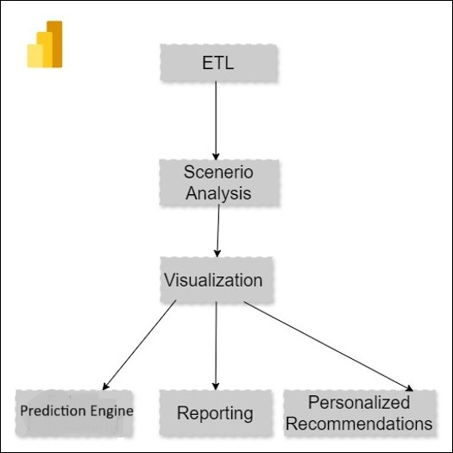
Concept Diagram

Slide 4
Features List
ID | Feature | Description
FT01 | Energy Data Acquisition | This feature interacts with user to get input data from user through csv/xml.
FT02 | Energy Data Storage | This units extracts data from csv/xml inputted by user and stores in Database.
FT03 | ETL | This Module extracts data from database transforms it and loads into our system.
FT04 | Scenario Analysis | The system must analyze historical data and generate patterns for production and consumption, as well as associations between energy import, generation, and production etc.
FT05 | Prediction Engine | The system must use WisRule, Linear Regression, K Means Clustering for prediction based on different scenarios
FT06 | Data Visualization | The system must visualize both historical data and predicted data on dashboard using graphs and charts.
FT07 | Reporting | The system must allow to share and print reports both in hard and soft form.
FT08 | Personalized Recommendations | The system must provide user with recommendations for future decision based on historical and predicted data.

Slide 5
Completed Features so far
ID | Feature | Status
FT01 | Energy Data Acquisition | Completed
FT02 | Energy Data Storage | Completed
FT03 | ETL | Completed
FT04 | Scenario Analysis | Not implemented yet
FT05 | Prediction Engine | At its initial Stage
FT06 | Data Visualization | Partial
FT07 | Reporting | Not implemented yet
FT08 | Personalized Recommendations | Not implemented yet

Slide 6
Design Methodology
IESA follows the Structural programming approach.
In structural programming, we divide a program in modules and each module is a software component or a part of program that contains one or more function, procedure, or method. IESA contains modules and each module serves separate operation

Slide 7
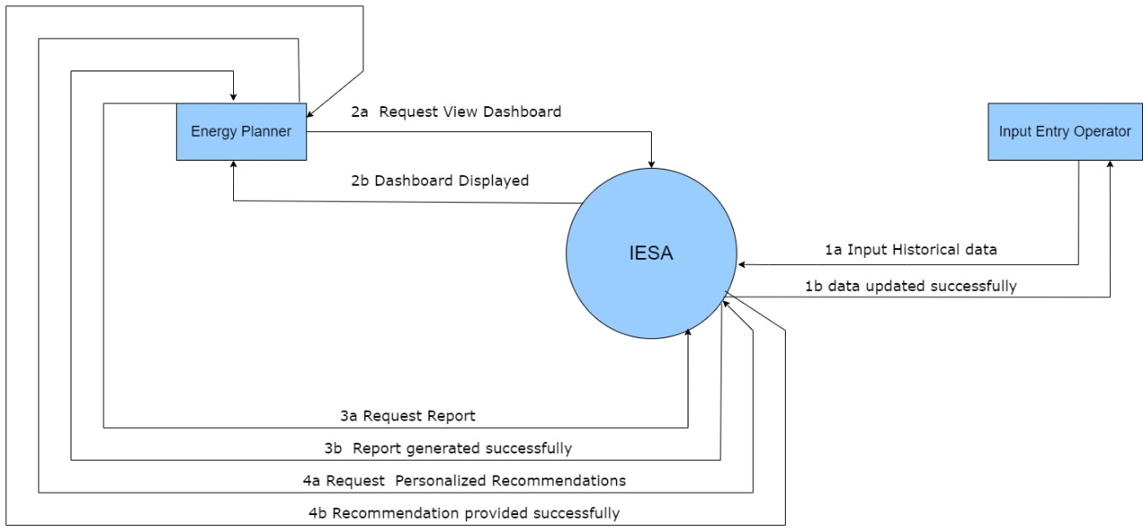
Context diagram

Slide 8
Traceability
Req. ID | Requirement Description | Feature ID | Feature Description | Verification Method
FR01 | The system shall allow user to input historical data in CSV/XML format. | FT01 | Data Input Interface for uploading historical data files. | System Test: Data upload
FR02 | The System shall store input data in database. | FT02 | Data Storage functionality in MS SQL database. | Database Test: Data storage
FR03 | The System shall extract data from database clean it and prepare it and load it into system | FT03 | ETL Process: Data cleaning and loading. | System Test: ETL process
FR04 | The system shall analyze historical data and generate patterns for different energy scenarios. | FT04 | Analytical Module for historical pattern generation. | System Test: Scenarios Analysis
FR05 | The system shall use WisRule, K mean cluster, Linear Regression and other algorithms to predict future energy related scenarios. | FT05 | Forecasting using WisRule and other algorithms for future energy trends. | Algorithm Test: Compare prediction accuracy
FR06 | The system shall visualize both historical data, different scenarios and predicted data on dashboard using graphs and charts. | FT06 | Dashboard for data visualization using graphs and charts. | UI Test: Dashboard visuals
FR07 | The system shall allow to share and print reports both in hard and soft form. | FT07 | Reporting Module for hard and soft copy outputs. | System Test: Report generation
FR08 | The system shall provide user with recommendations for future decision based on historical and predicted data. | FT08 | Recommendation Engine for decision support. | System Test: Recommendations

Slide 9
Traceability
Traceability
Requirement ID | Requirement Description | Feature ID | Feature Description | Verification Method
FR01 | The system shall allow user to input historical data in CSV/XML format. | FT01 | Data Input Interface for uploading historical data files. | System Test: Data upload
FR02 | The System shall store input data in database. | FT02 | Data Storage functionality in MS SQL database. | Database Test: Data storage
FR03 | The System shall extract data from database clean it and prepare it and load it into system | FT03 | ETL Process: Data cleaning and loading. | System Test: ETL process
FR04 | The system shall analyze historical data and generate patterns for different energy scenarios. | FT04 | Analytical Module for historical pattern generation. | System Test: Scenarios Analysis
FR05 | The system shall use WisRule, K mean cluster, Linear Regression and other algorithms to predict future energy related scenarios. | FT05 | Forecasting using WisRule and other algorithms for future energy trends. | Algorithm Test: Compare prediction accuracy
FR06 | The system shall visualize both historical data, different scenarios and predicted data on dashboard using graphs and charts. | FT06 | Dashboard for data visualization using graphs and charts. | UI Test: Dashboard visuals
FR07 | The system shall allow to share and print reports both in hard and soft form. | FT07 | Reporting Module for hard and soft copy outputs. | System Test: Report generation
FR08 | The system shall provide user with recommendations for future decision based on historical and predicted data. | FT08 | Recommendation Engine for decision support. | System Test: Recommendations

Slide 10
Group Members Individual Progress
Each Group member should show individual progress by showing the list of features allocated to him/her and the progress in terms of the amount of code written so far
Make it in a table.
At least each member should show 20/30 percent code

Slide 11
Gantt Chart and Workload

Slide 12
Tools and tech
Database:
MY SQL
Tools:
Streamlit
PowerBI
PyCharm/VS Code
MY SQL workbench
Chrome
Programming Language:
Python
SQL

Slide 13
References
LEAP: Long-range Energy Alternatives Planning System. Retrieved from https://www.energycommunity.org/default.asp?action=LEAP
EnergyPLAN: Retrieved from https://www.energyplan.eu/
HOMER Pro: Retrieved from https://www.homerenergy.com/products/pro/
PLEXOS: Retrieved from https://www.energyexemplar.com/solutions/plexos
Open Source Energy Modelling System: Retrieved from https://oset.org/
LoadSEER: Retrieved from https://www.integralanalytics.com/loadseer/
ETAP: Retrieved from https://etap.com/
Seimens PSS/E: Retrieved from https://new.siemens.com/global/en/products/energy/services/transmission-distribution-smart-grid/consulting-and-planning/pss-software.html
IEEE style: https://www.bath.ac.uk/publications/library-guides-to-citing-referencing/attachments/ieee-style-guide.pdf
WisRule:https://www.researchgate.net/publication/361788259_WisRule_First_cognitive_algorithm_of_wise_association_rule_mining

Slide 14
Present Demo

